Slide 1
Lecture 2
INTRODUCTION TO COMPUTING

Slide 2
Outline
Numbering and Coding Systems
Digital Primer
Inside the Computer

Slide 3
Numbering And Coding Systems
There are two types of number systems:
Computer uses base 2, binary in 0 & 1 (bits)
Human being normally use base 10.
Decimal Number Systems
Binary Number Systems
There are ten distinct symbols, 0,1,2,…,9
Octal Number
Hexadecimal Number
Alphanumeric Code (ASCII)

Slide 4

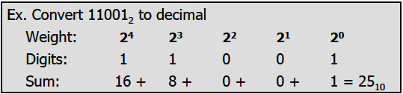
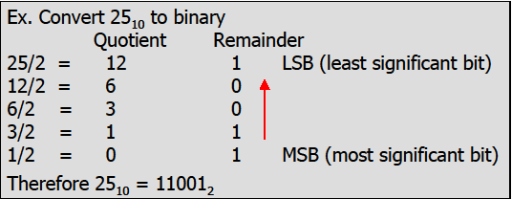
Conversions
Decimal to Binary
Binary to Decimal

Slide 5
Examples
Convert the binary number to decimal:
(a) 1011 (b) 1100101 (c) 10111
Ans: 1110 Ans: 10110 Ans: 2310
Use the concept of weight to convert 3910 to binary:
Ans: 1001112

Slide 6
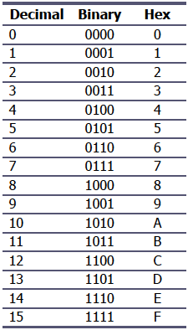


Hexadecimal Systems
Base 16, the hexadecimal system, is used as a convenient representation of binary numbers
Example:
It is much easier to represent a string of 0s and 1s such as:
100010010110
896H or 0x8E
Notes:
Conversions: 1000 1110 (binary) to 8E(hex), Notations for hex:
0x8E or 8Eh or 8E₁₆

Slide 7
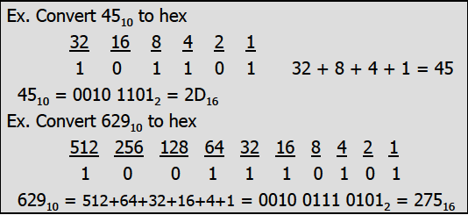
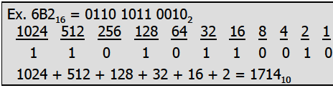
Conversions
Decimal to Hex
Hex to Decimal
Convert to binary first and then convert to hex
Convert from hex to binary and then to decimal
Convert directly from decimal to hex
by repeated division, keeping track of
the remainders
Convert directly from hex to decimal by summing the weight of all digits

Slide 8
Examples
Convert the following decimal number to Hex :
(a) 4510 (b) 62910 (c) 171410
Ans: 2D hex Ans: 275 Hex Ans: 6B2 Hex
Convert the following hexadecimal number to decimal :
6B216 (b) 9F2D16
Ans: 10011110 Ans: 4074910

Slide 9
Counting in Base 10, 2 and 16
Decimal Binary Hex
0 00000 0
. . .
. . .
. . .
16 10000 10
17 10001 11
18 10010 12
. . .
. . .
. . .
29 11101 1D
30 11110 1E
31 11111 1F

Slide 10
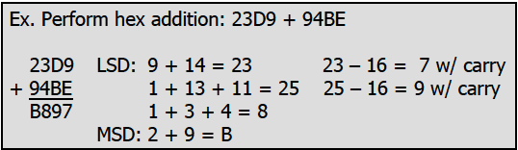
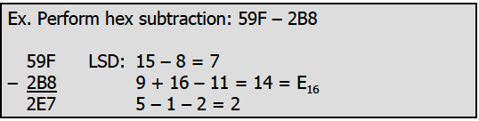
Addition & Subtraction of Hex Numbers
Adding the digits together from the least significant digits
  If the result is less than 16, write that digit as the sum for that position
  If it is greater than 16, subtract 16 from it to get the digit and carry 1 to the next digit
Subtract the digits from the least significant digits
  If the second digit is greater than the first, borrow 16 from the preceding digit

Slide 11
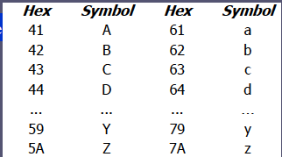
ASCII Code
The ASCII (pronounced “ask-E”) code assigns binary patterns for
  Numbers from 0 to 9
  All the letters of English alphabet, uppercase and lowercase
  Many control codes and punctuation marks
The ASCII system uses 7 bits to represent each code

Slide 12
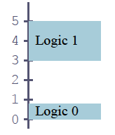
DIGITAL PRIMER
Binary Logic
  Two voltage levels can be represented as the two digits 0 and 1
  Signals in digital electronics have two distinct voltage levels with built in tolerances for variations in the voltage
  A valid digital signal should be within either of the two shaded areas

Slide 13
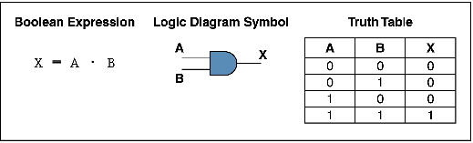
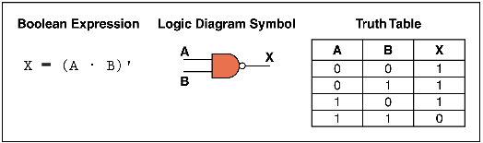
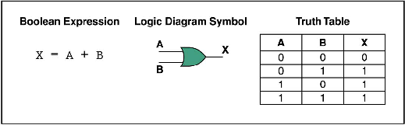
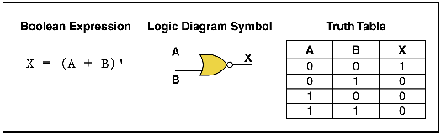
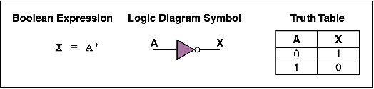
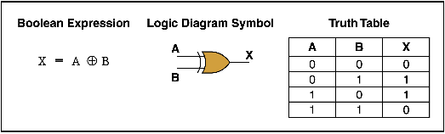
Cont…
Tri-state Buffer
X
Y
Control

Slide 14
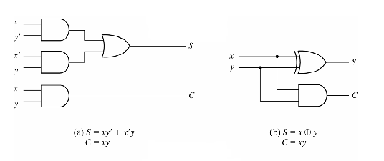
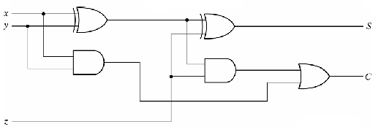
Cont…
Half Adder
Full Adder

Slide 15
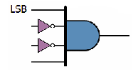
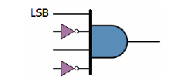
Cont…
Decoders
  Decoders are widely used for address decoding in computer design
Address decoder for 9 (10012)
The output will be 1 if and
only if the input is 10012
Address decoder for 5 (01012)
The output will be 1 if and
only if the input is 01012

Slide 16
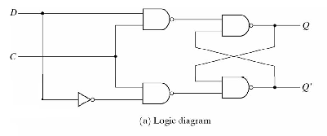
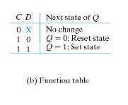
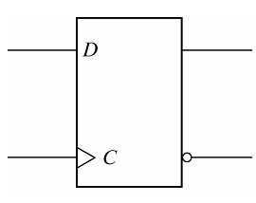
Cont…
Flip-flops
  Flip-flops are frequently used to store data

Slide 17
Important Terminology of Data Size
The unit of data size
  Bit : A binary digit that can have the value 0 or 1
  Byte : 8 bits
  Nibble : Half of a byte, or 4 bits
  Word : Two bytes, or 16 bits
The terms used to describe amounts of memory in IBM PCs and compatibles
  Kilobyte (K) : 2¹⁰ bytes
  Megabyte (M) : 2²⁰ bytes, over 1 million
  Gigabyte (G) : 2³⁰ bytes, over 1 billion
  Terabyte (T) : 2⁴⁰ bytes, over 1 trillions

Slide 18
Internal Organization of Computers
CPU (Central Processing Unit)
  Execute information stored in memory
I/O (Input/output) devices
  Provide a means of communicating with CPU
Memory
  RAM (Random Access Memory)
    Temporary storage of programs that computer is running
    The data is lost when computer is off
  ROM (Read Only Memory)
    Contains programs and information essential to operation of the computer
    The information cannot be changed by use and is not lost when power is off
    It is called nonvolatile memory

Slide 19
Cont…
Central Processing Unit (CPU)
Address Buses
Memory
(RAM & ROM)
Peripherals
(Monitor, Printer, etc)
Data Buses

Slide 20
Cont…
The CPU is connected to memory and I/O through strips of wire called a “ bus ”, It carries information from place to place
For a device (memory or I/O) to be recognized by the CPU, it must be assigned an ddress.
The address assigned to a given device must be unique.
The CPU puts the address on the address bus, and the decoding circuitry finds the device
CPU
Address Bus
RAM
ROM
Printer
Disk
Monitor
Keyboard
Read
/ Write
Data Bus
Control Bus
The CPU either gets data from the device or sends data to it
Provides read or write signals to the device to indicate if the CPU is asking for information or sending it information

Slide 21
Data Bus
The more data buses available, the better the CPU
Think of data buses as highway lanes
More data buses mean a more expensive CPU and computer
  The average size of data buses in CPUs varies between 8 and 64
Data buses are bidirectional
  To receive or send data
The processing power of a computer is related to the size of its buses

Slide 22
Address Bus
The more address buses available, the larger the number of devices that can be addressed
The number of locations with which a CPU can communicate is always equal to 2^{x}, where x is the address lines, regardless of the size of the data bus
  For example a CPU with 24 address lines and 16 data lines can provide a total of 2²⁴ or 16M bytes of addressable memory
  Each location can have a maximum of 1 byte of data, since all general-purpose CPUs are byte addressable
The address bus is unidirectional

Slide 23
CPU’s Relation to RAM & ROM
The data must be stored in RAM or ROM, which are referred to as primary memory
ROM provides information that is fixed and permanent
  Tables or initialization program
RAM stores information that is not permanent and can change with time
  Various versions of OS and application packages
  CPU gets information to be processed
    first form RAM (or ROM)
    if it is not there, then seeks it from a mass storage device, called secondary memory, and transfers the information to RAM

Slide 24
Inside CPU’s
Registers
The CPU uses registers to store information temporarily
  Values to be processed
  Address of value to be fetched from memory
In general, the more and bigger the registers, the better the CPU
  Registers can be 8-, 16-, 32-, or 64-bit
  The disadvantage of more and bigger registers is the increased cost of such a CPU

Slide 25
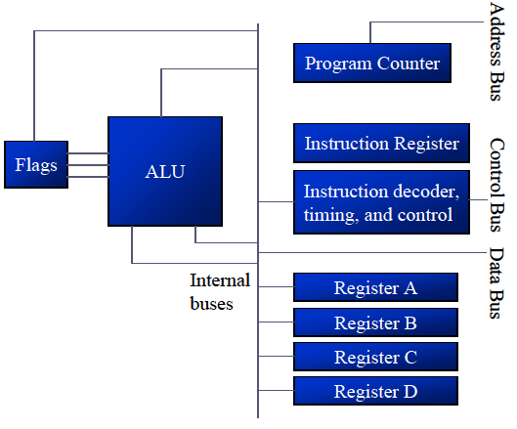
Cont…
Points to the address of the next instruction to be executed
As each instruction is executed, the program counter is incremented to point to the address of the next instruction to be executed
Interprets the instruction fetched into the CPU
A CPU capable of understanding more instructions requires more transistors to design
Performs arithmetic functions such as add, subtract, multiply, and divide, and logic functions such as AND, OR, and NOT

Slide 26
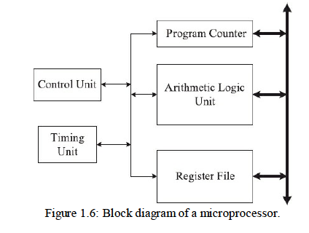
Microprocessor

Slide 27
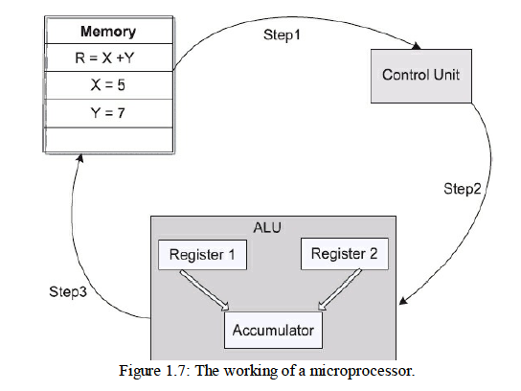
Microprocessor
The microprocessor fetches the instruction by applying PC contents on the address
bus, a read signal on the control bus
The control unit decodes its opcode
Processor executes R = X + Y by
– fetching the current value of X from the memory
– fetching the current value of Y from the memory
– instructing the ALU to add these two numbers
– writing the sum back to the memory address of R

Slide 28
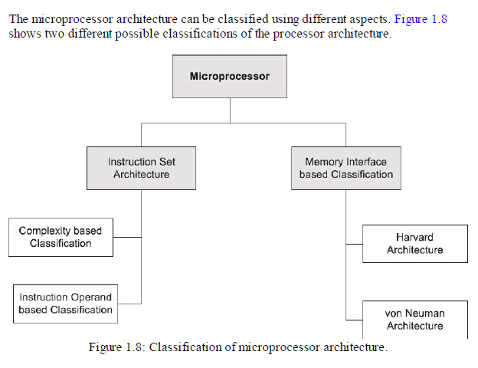
Microprocessor Architecture Classification

Slide 29
Instruction Set Architecture (ISA)
Classification
  Complexity of Instructions
    complex instruction set computer (CISC)
      Early Computer
      Fetching Instruction from Memory is Bottleneck
      Require many clock cycle
      Complex Instruction: Small program require high code density
      Have different addressing modes require special register
      Intex x86, 8051,
    Reduced instruction set computer (RISC)
  Instruction Operands

Slide 30
Instruction Set Architecture (ISA)
Reduced instruction set computer (RISC)
  Processor speeds match that of memories
  Speed matching reduces the penalty for instruction
  Parameter fetching from the memory
  Simplified instructions used by this architecture
  Each complex operation is broken into multiple simplified operations
  load and store instructions are provided for memory read and write operations
  simplified instructions make it possible to execute an instruction in a single processor clock cycle
  instructions in RISC may require more than one clock cycle
  RISC computer requires a relatively larger number of simplified instructions and results in low code density
  fewer memory addressing modes resulting in reduced complexity
  hardware architecture in RISC is complemented by the Increased complexity in the generation of assembly code by the tools (compiler) or by the programmer.
  Processor based on RISC architecture are ARM, Power PC,
  it is very difficult to compare the execution speed of two computers CISC and a RISC
  50 MHz ARM Cortex-M processor has one bus cycle every 20 ns
  it may require 1.5 cycles per instruction
  10,000,000 assembly instructions
  ime to execute the benchmark will be 0.33 seconds

Slide 31
Instruction Operand-Based ISA Classification
assembly language program in general have multiple operands
The operands for an instruction can be specified either using memory or registers or combination of both.
Memory-memory: This type of ISA allows more than one operand of most instructions to be specified in memory
Register-memory: These architectures allow one operand of an instruction to be
  specified in memory, while the other operand is in CPU register
  x86 and Motorola 68k are example
  ISA the individual instructions execute faster, compared to memory-memory based ISA
Register-register: ISA classification is also called load-store architecture
  Direct access to the memory is not allowed to most of the instructions in this ISA
  load and store instructions, are responsible for any data movement between registers and memory.
  execution of most of the instructions in load-store ISA is very fast
  load-store based ISA requires the most number of instructions to complete a given task

Slide 32
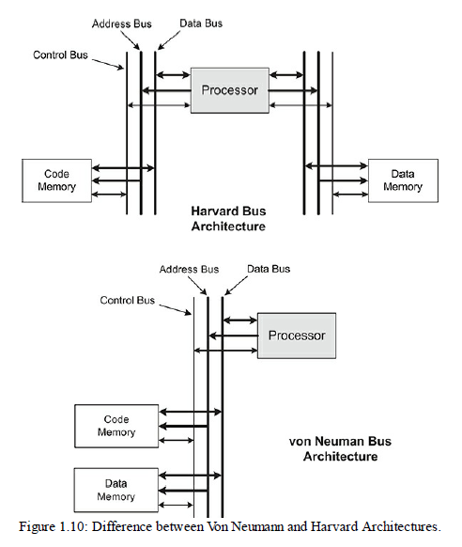
Memory Interface-Based Architecture Classification
Von Neumann architecture:
uses a common bus for both data as well as code memory.
instruction can be fetched from memory or data can be read/written to/from memory during each memory access cycle
Instructions and data are stored in the same memory subsystem and share a common bus to the processor
Harvard architecture
separate buses for accessing code and data memories.
separate buses for code and data memories allows instructions and data to be accessed simultaneously
Pipelining decreases the per instruction execution time
main memory access time is a major bottleneck
Mostly, microprocessors are implemented using von Neumann architecture
microcontrollers use Harvard architecture ARM based microcontrollers use Harvard architecture

Slide 33
Chapter 0 Concluded
Read theory from chapter
Review questions
Problems from the exercise

